Slide 1
Implementation Training Welcome! Please open the support website www.deltamath.org
Ottawa Area ISD ©2020

Slide 2
Introductions
Mike Klavon (Development & Implementation)
Ottawa Area ISD
Alt+Shift
An Individuals with Disabilities Education Act (IDEA) Grant Funded Initiative through the Michigan Department of Education, Office of Special Education.

Slide 3
Today’s Topics
Delta Math Preview
What should all students know and be able to do?
How will we know if students know and can do it?
What will we do when they don’t know or can’t do it?
What will we do when they know and can do it?

Slide 4
Tiers of Support
Intensive support on standards from 2 or more previous grade levels
Tier 3
Targeted support on standards from the previous grade level
Tier 2
Support on standards from the current grade level
Tier 1

Slide 5
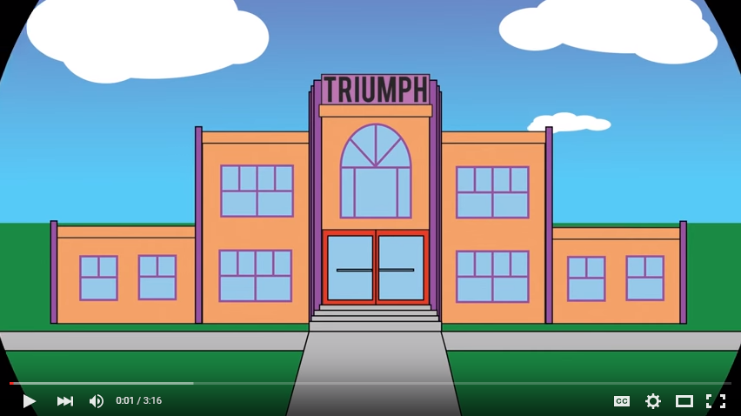
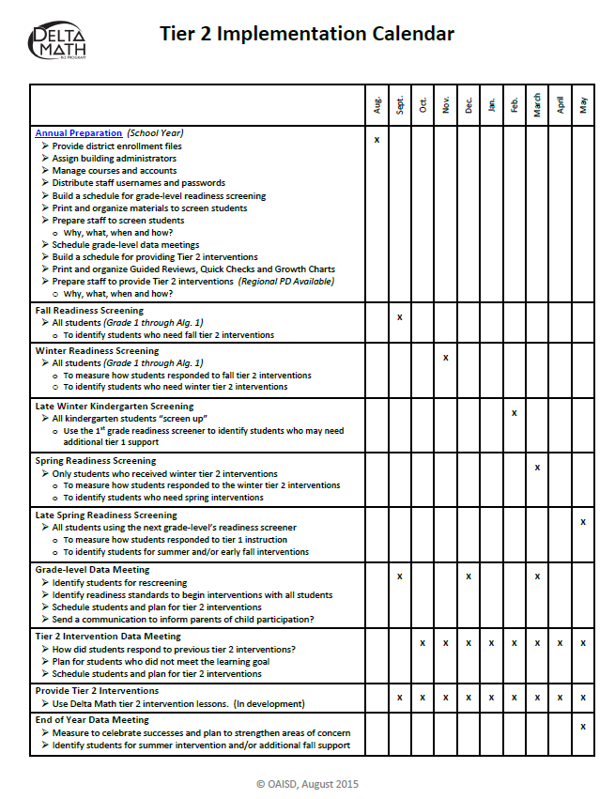
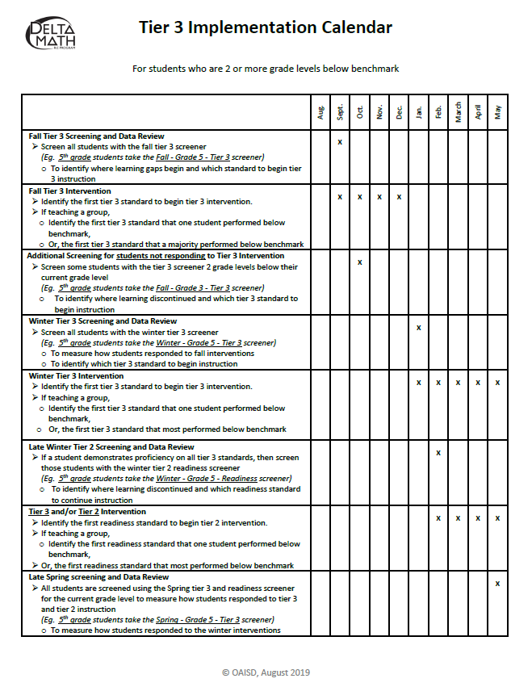
Implementation Video
Watch and Reflect:
What did you notice? What do you wonder?
Open and scan an Implementation Calendar.
What screeners are recommended and when?

Slide 6
Topic 2
Delta Math Preview
What should all students know and be able to do?
How will we know if students know and can do it?
What will we do when they don’t know or can’t do it?
What will we do when they know and can do it?

Slide 7
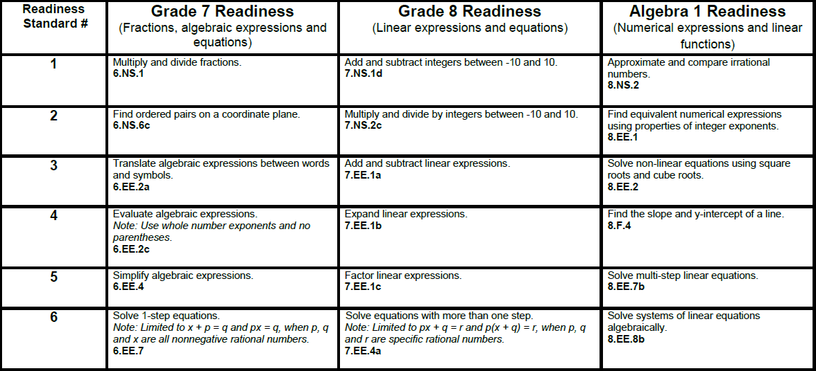
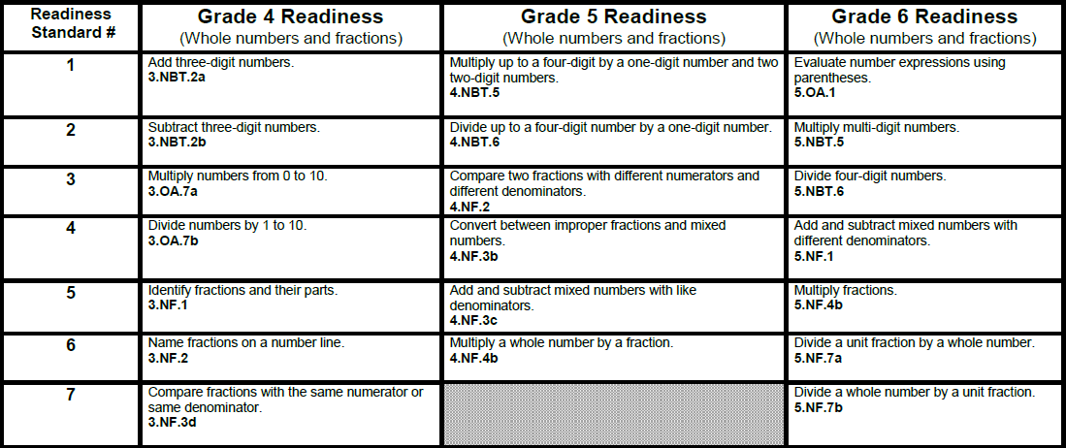
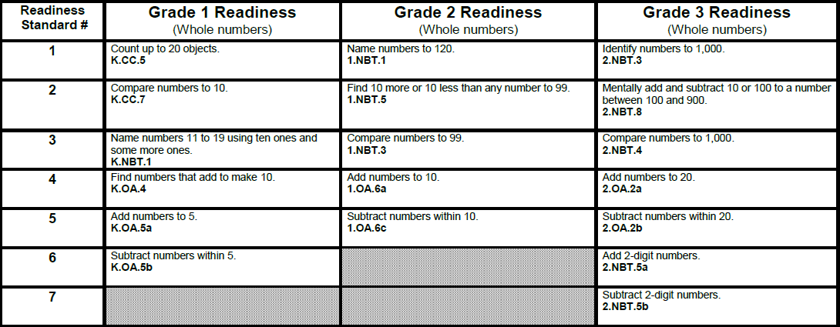
What should students know?
Focus on whole numbers, fractions, integers and algebraic concepts
Fall, winter and spring measure the same readiness standards.
High priority, end-of-year benchmarks from previous year common core state standards.
Most readiness standards are measured using 3 questions.
Benchmark is 2 out of 3 correct.
Timed facts - Grades 1 through 4.
Benchmark is 10 correct in 1 minute.
Tier 3 and Standards by Grade Level are available at www.deltamath.org

Slide 8
Topic 3
Delta Math Preview
What should all students know and be able to do?
How will we know if students know and can do it?
What will we do when they don’t know or can’t do it?
What will we do when they know and can do it?

Slide 9
Online Screening
Observe a 4th grade screening session:
Student’s sign in
Safety Icons
Work paper
Question types
Timed facts
Turning in
Note: Option 2 is available for grades 6 through Algebra 2

Slide 10
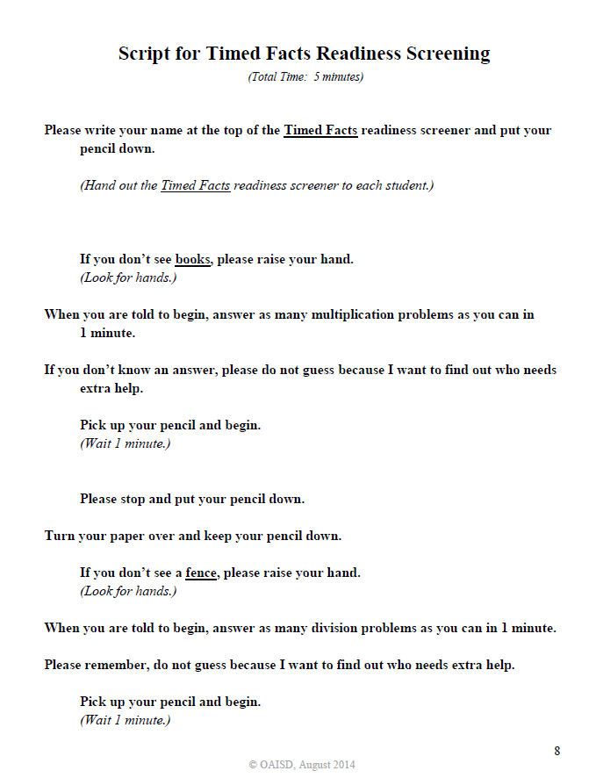
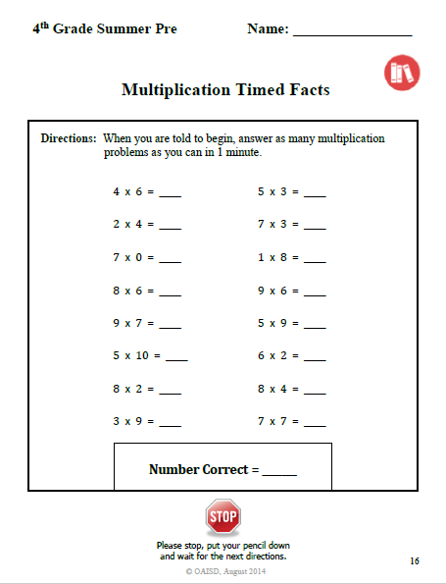
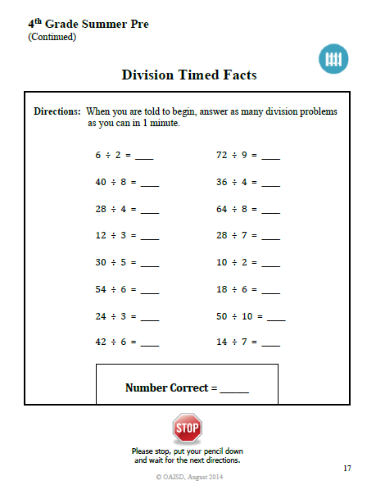
Timed Facts Readiness
Who? Grades 1 through 4
When? Completed and scored before online screening
What? Benchmark is 10 correct in 1 minute

Slide 11
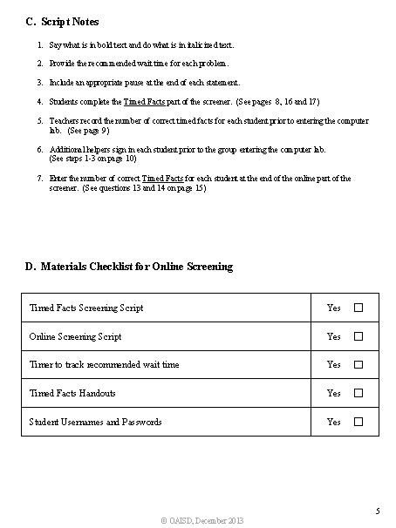
Screening Support
Open and explore a readiness screening packet.
Online & Paper Screening Tab
Preview page 5
Find the Timed Facts and Work Paper

Slide 12
We will begin again @ _____
15 Minute Break

Slide 13
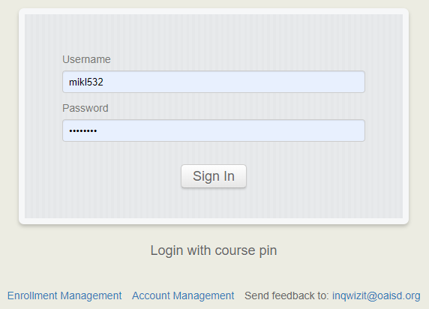
Explore
https://inqwizit.oaisd.org
Sign in using the temporary Course PIN
Click through a 4th Grade Readiness Screener
Analyze the data

Slide 14
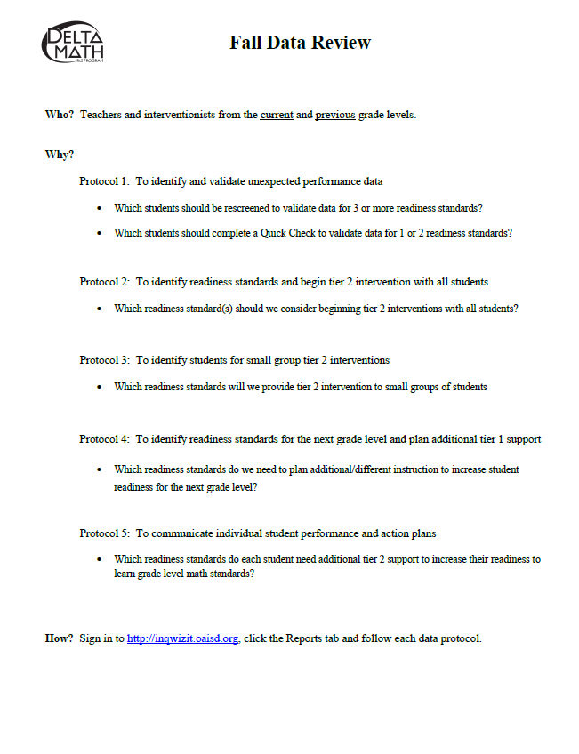
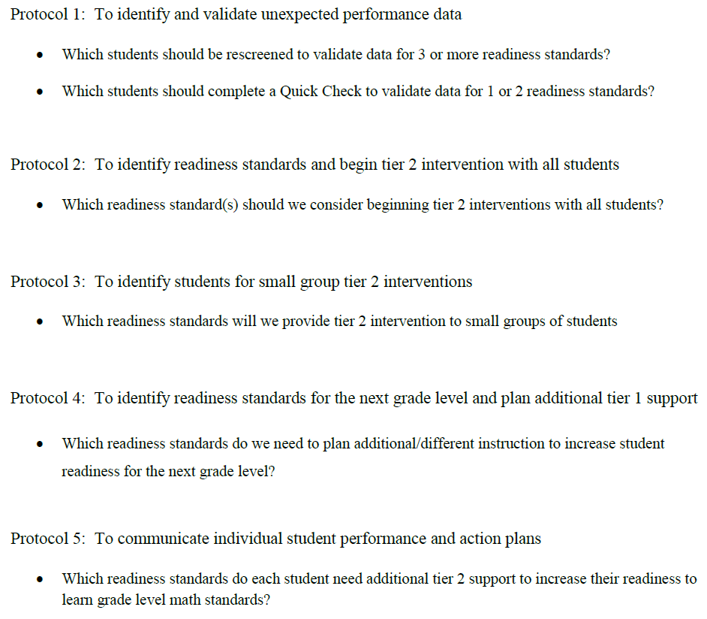
Fall Data Review

Slide 15
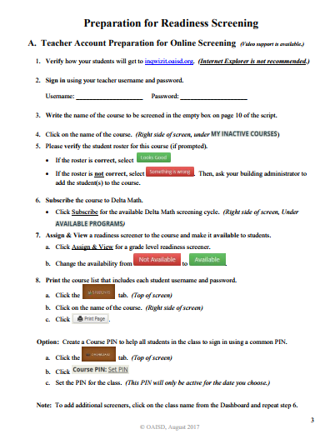
Online Preparation
(page 3 in every Screening Packet)
Highlight page 3
Verify, Subscribe, Assign and View, make it available and create a Course PIN
Additional Supports:
Video
Contact Us
Watch me demonstrate and ask follow-up questions

Slide 16
Topic 4
Delta Math Preview
What should all students know and be able to do?
How will we know if students know and can do it?
What will we do when they don’t know or can’t do it?
What will we do when they know and can do it?

Slide 17
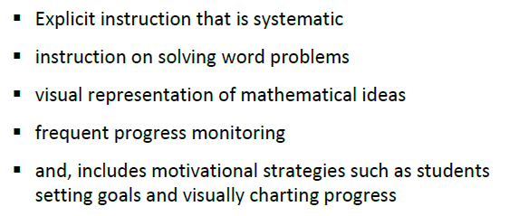
Evidence-based Strategies

Slide 18
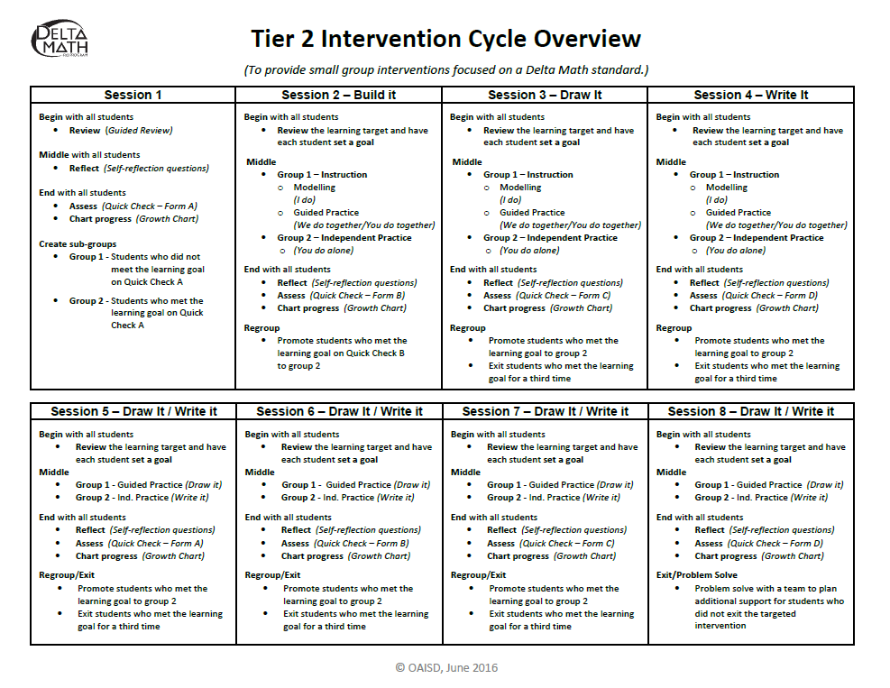
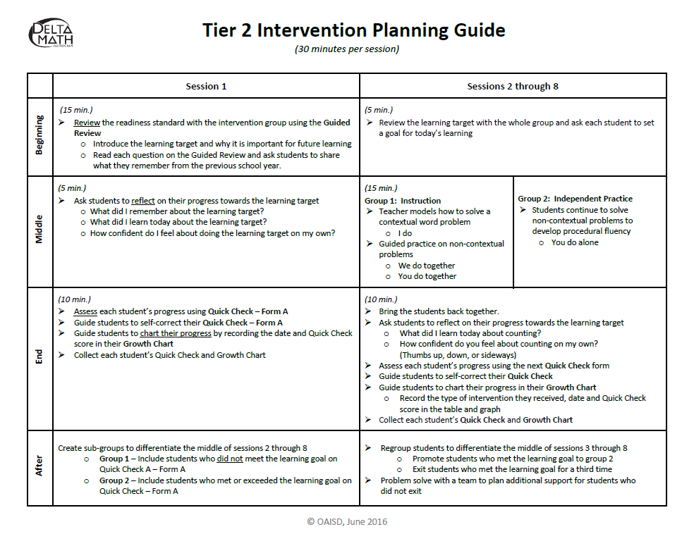
Tier 2 Intervention Cycle
Watch the support video
Discuss evidence-based strategies
Reflect on the Intervention Cycle Overview

Slide 19
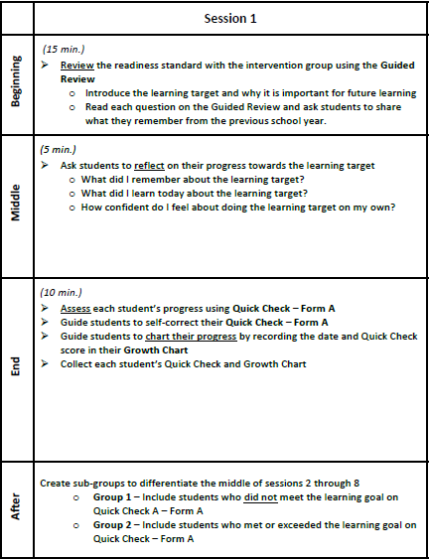
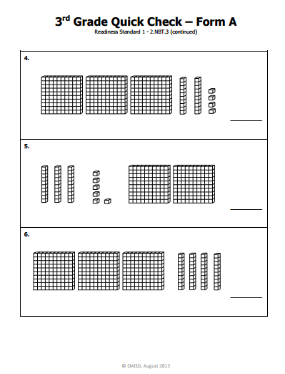
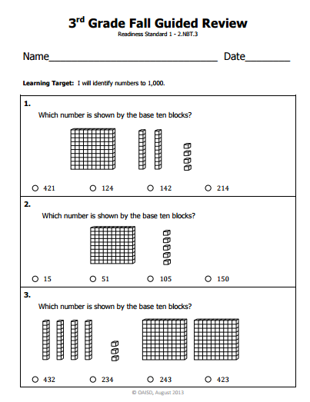
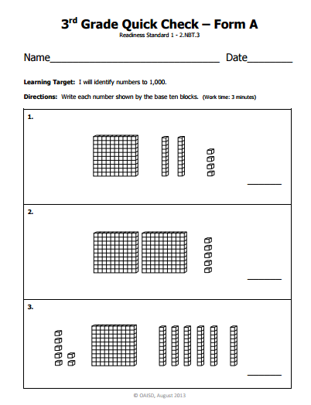
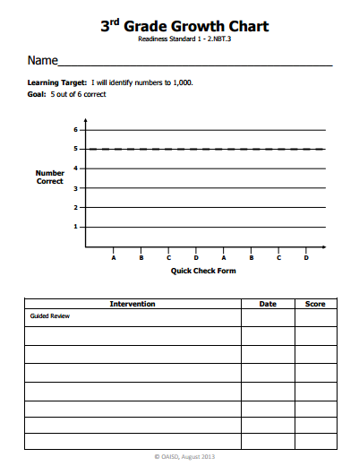
Tier 2: Session 1
Re-engage Students
Review
Reflect
Assess
Chart Progress
Create Sub-Groups
9/17 2
Session 2 (Base 10 Blocks) 9/17 2

Slide 20
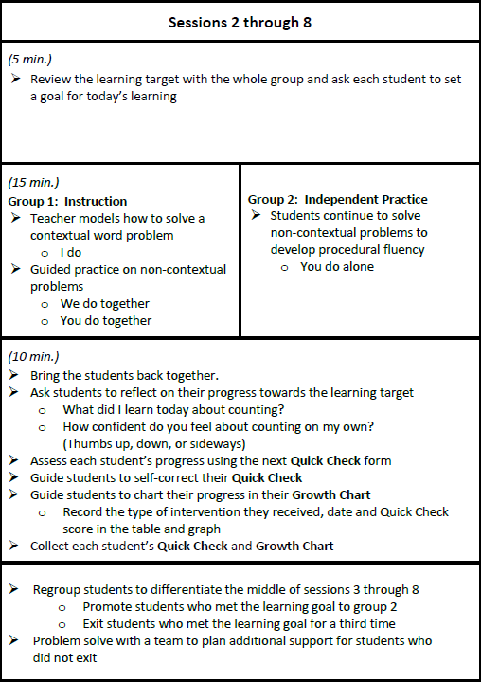
Tier 2: Sessions 2 → 8
Review / Set goals
Teach / Independent Practice
Reflect
Assess
Chart Progress
Regroup/Exit

Slide 21
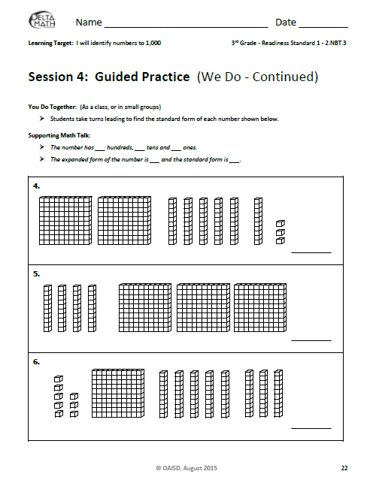
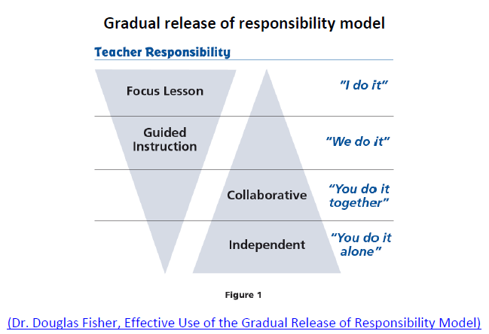
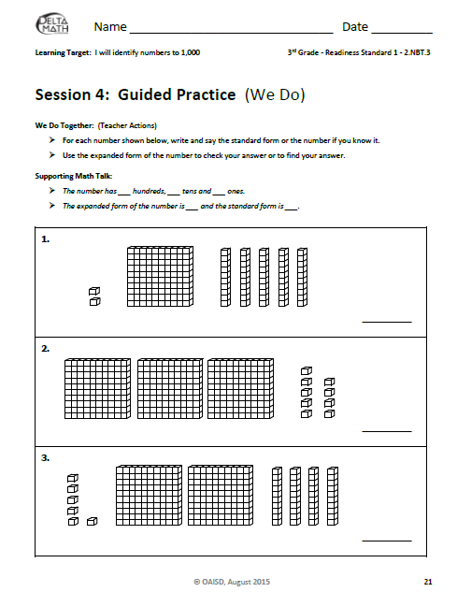
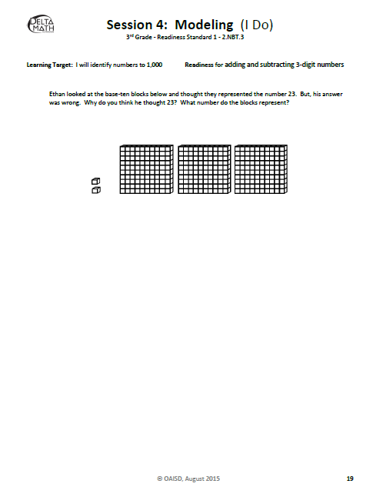
Gradual Release

Slide 22
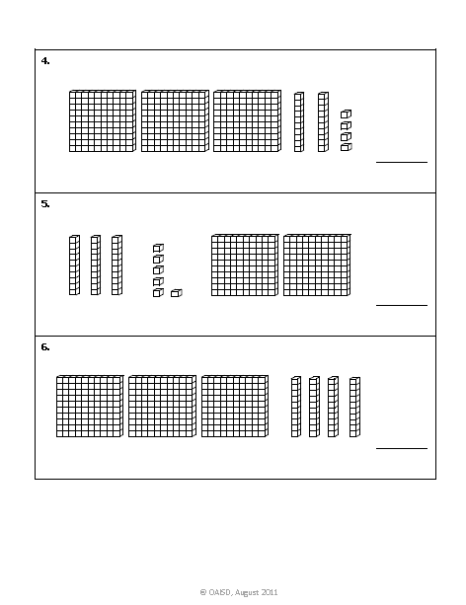
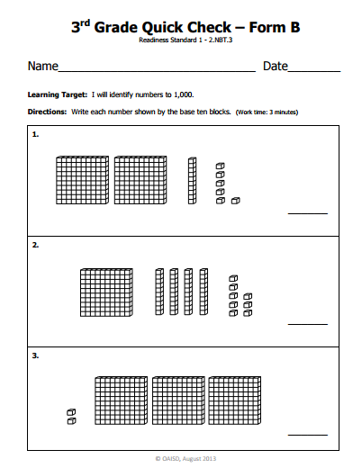
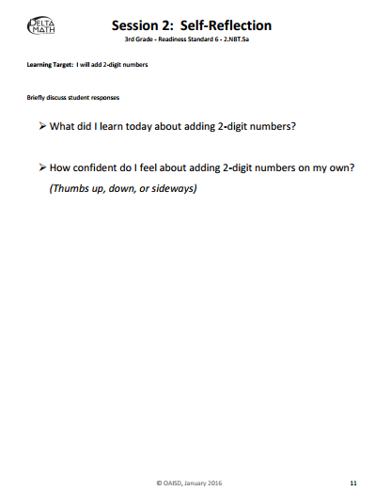
Reflect/Monitor Progress
9/17 2
Session 2 (Base 10 Blocks) 9/18 4

Slide 23
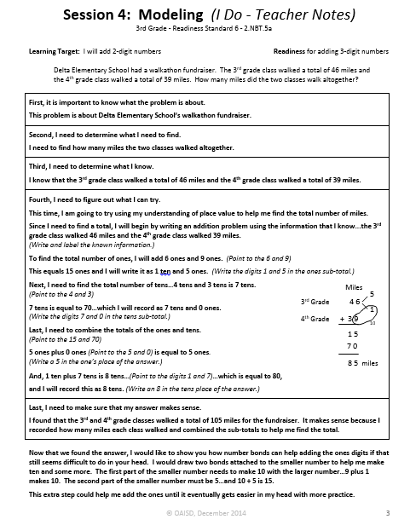
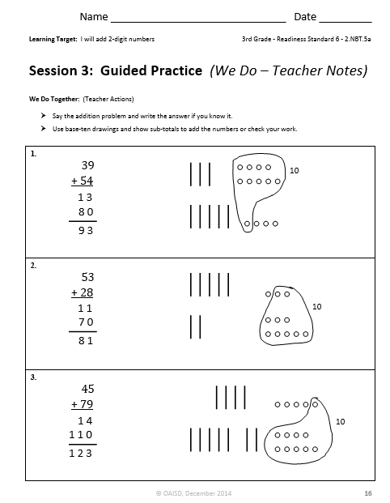
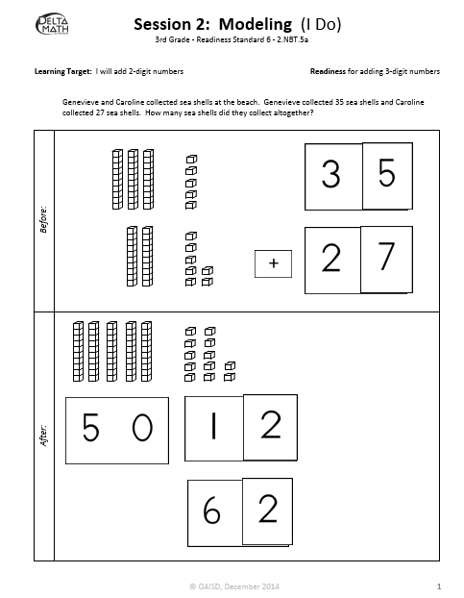
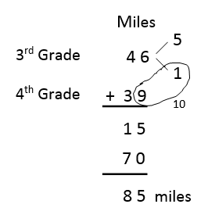
C-R-A (Sessions 2 → 4)

Slide 24
Student Motivation
Provide timely feedback
Students visually chart progress
Set personal goals for improvement
Reward students for accomplishments

Slide 25
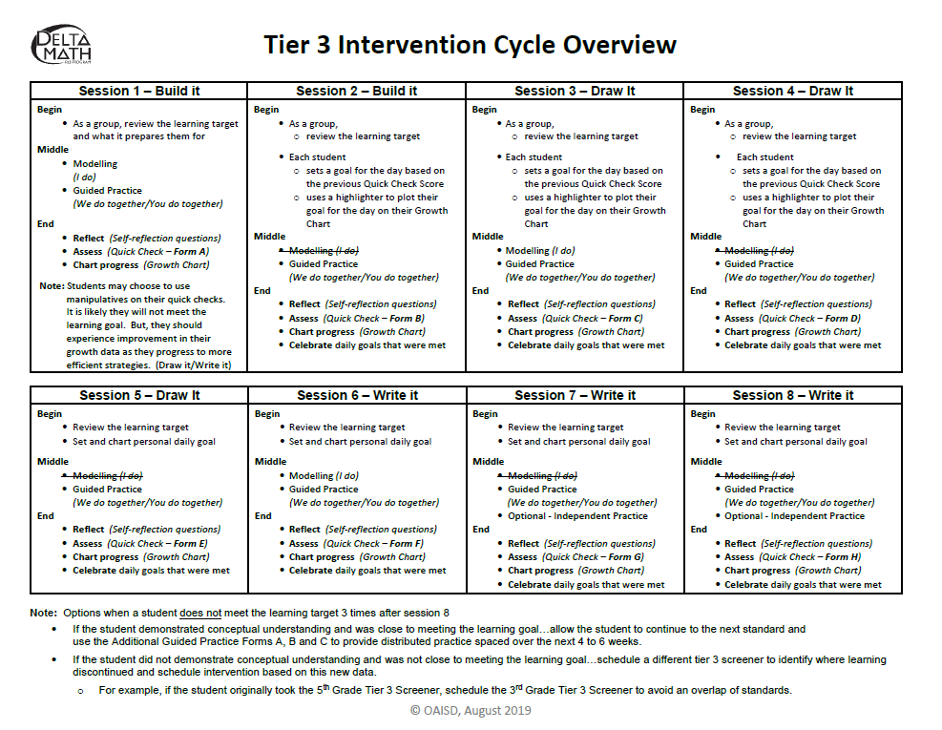
Tier 3 Instruction Cycle
Open an Intervention Cycle Overview and review the plan for each session.

Slide 26
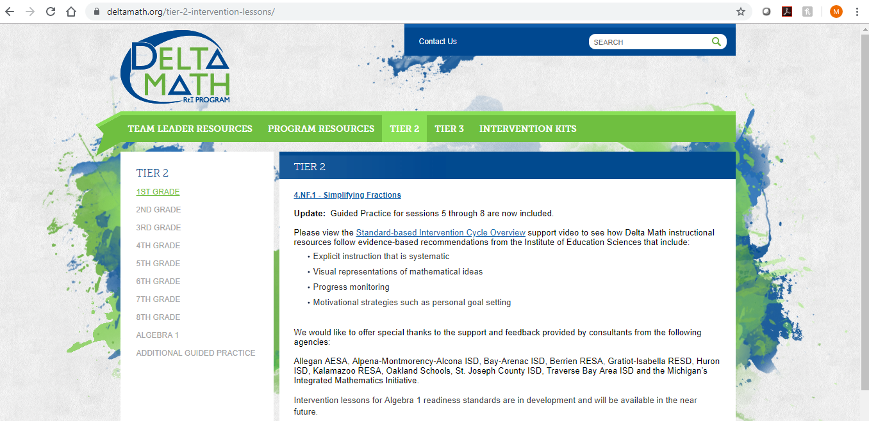
Locate and Preview
www.deltamath.org
Open a Teacher Copy and preview the Visual Support and Teacher Notes

Slide 27
Locate and Preview
www.deltamath.org
Additional resources include cards, mats and videos

Slide 28
Distributed Practice
When
During intervention: After students meet the learning goal
During math class: Warm-ups, closing activities, math centers, choice time and at-home practice
What
Visual Fluency Cards
Additional Guided Practice
Independent Practice
Online Practice

Slide 29
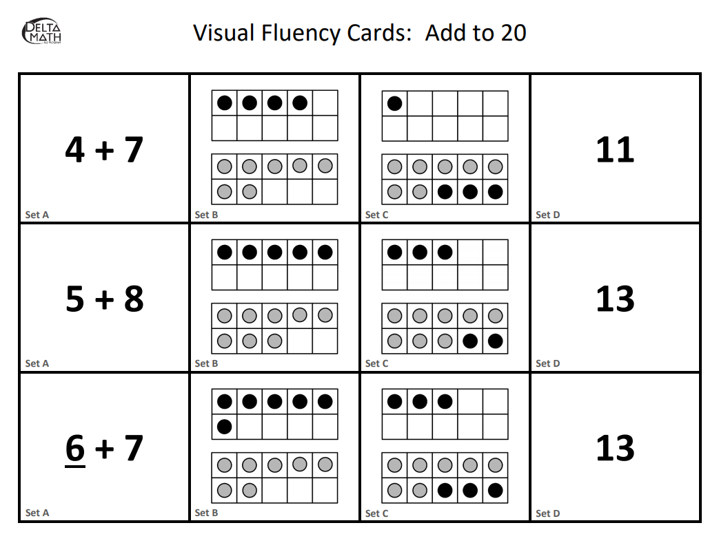
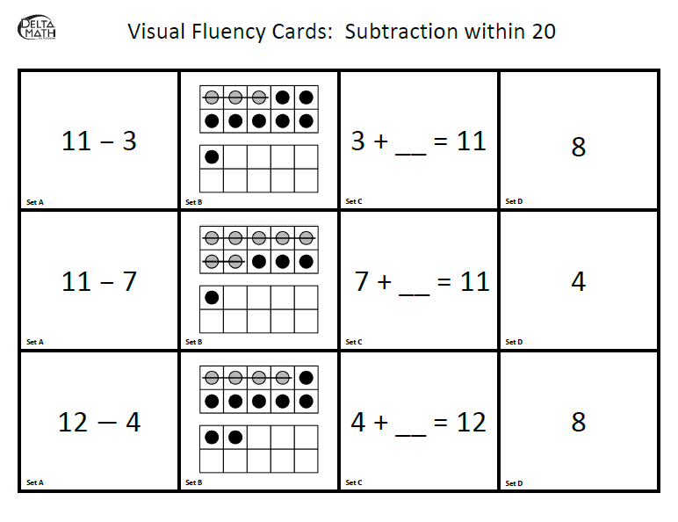
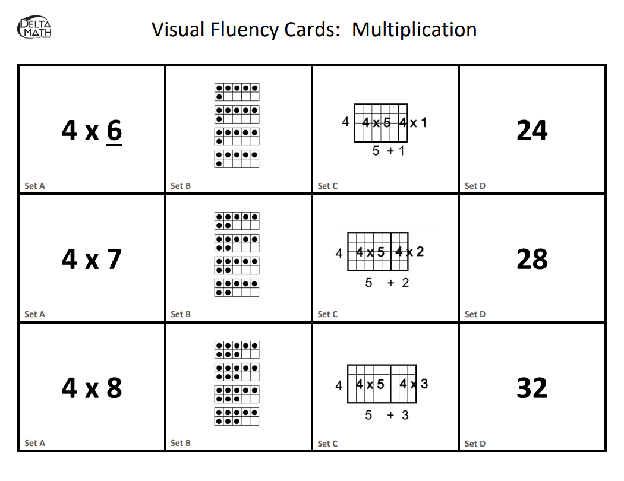
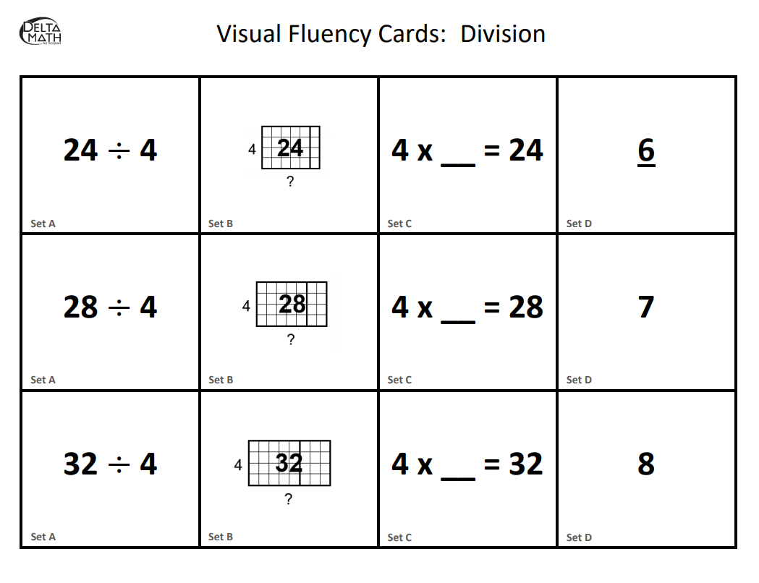
Visual Fluency Cards
Make a ten
Add to subtract
See and Think…
5 and some more
Multiply to divide

Slide 30
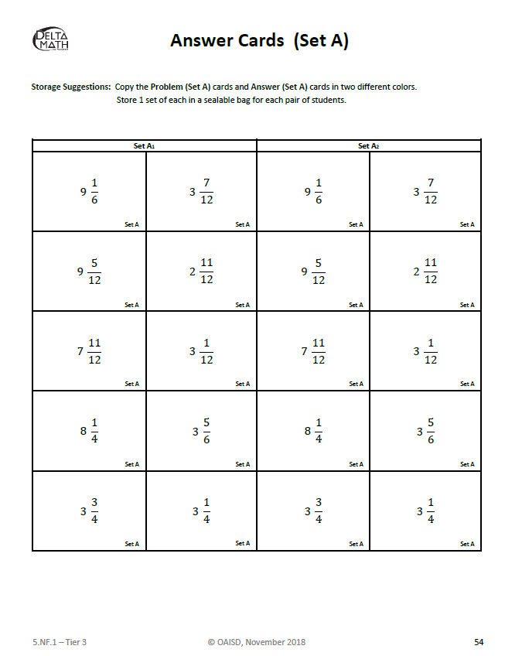
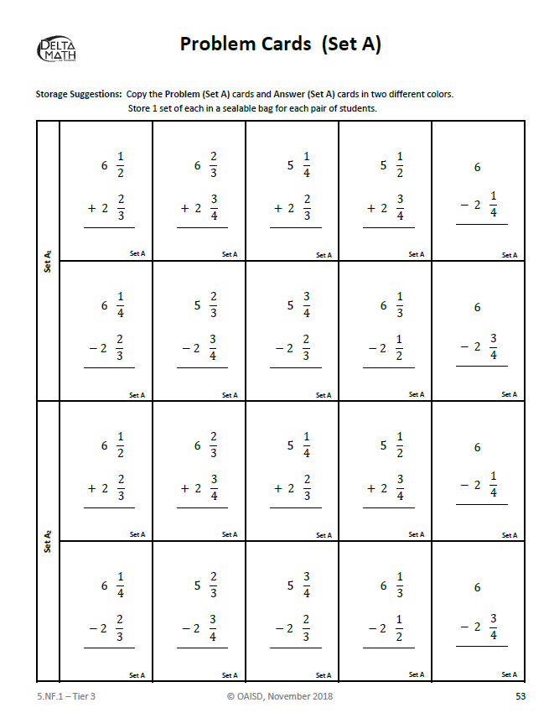
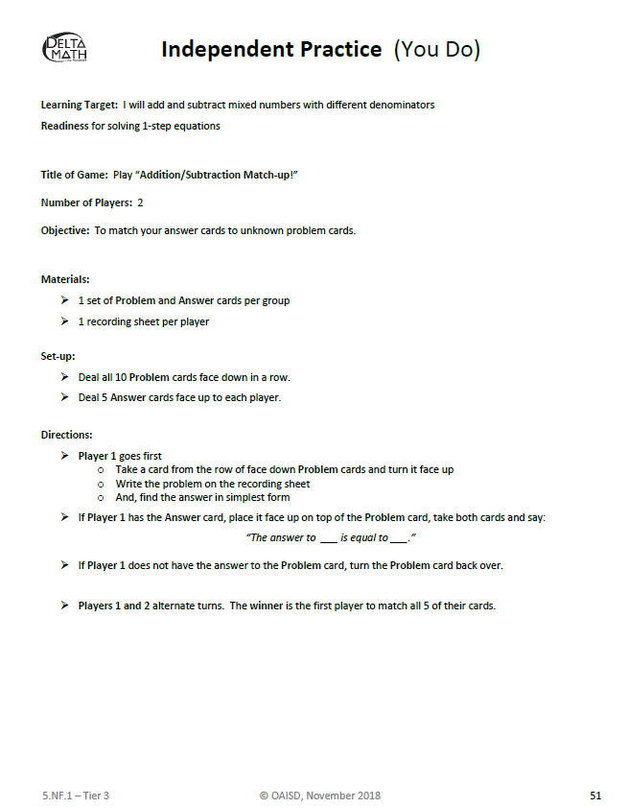
Independent Practice

Slide 31
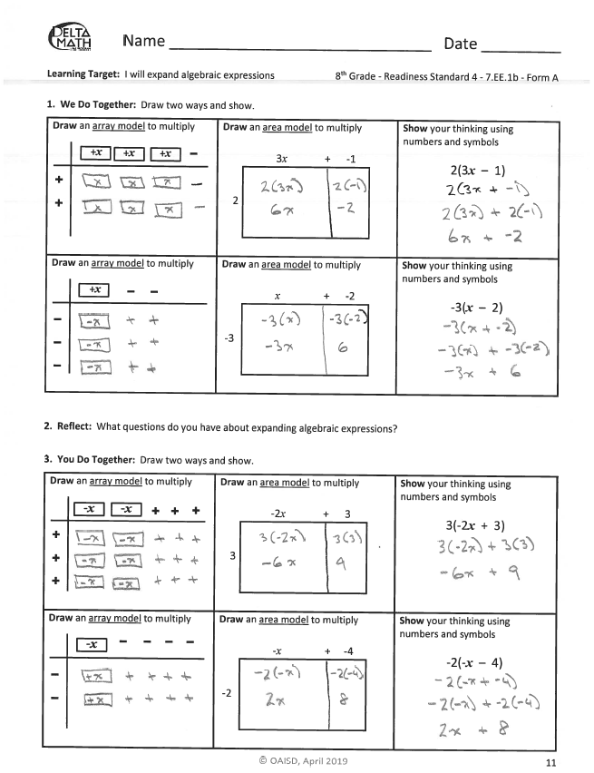
Additional Guided Practice
Available for 1st through 8th Grade Readiness
Gradual Release
We Do Together
Reflect
You Do Together
Build Procedural Fluency through Conceptual Understanding

Slide 32
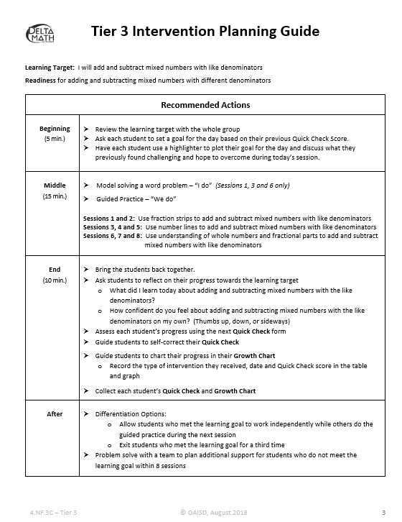
Reflect
Additional support may be requested by clicking “Contact Us”!

Slide 33
Thank You!
The Delta Math RtI Program was developed and technical support is provided by the Ottawa Area Intermediate School District (OAISD).
The development of Delta Math implementation resources is supported by Alt+Shift, an Individuals with Disabilities Education Act (IDEA) grant funded initiative through the Michigan Department of Education, Office of Special Education.

