Slide 1


Slide 2
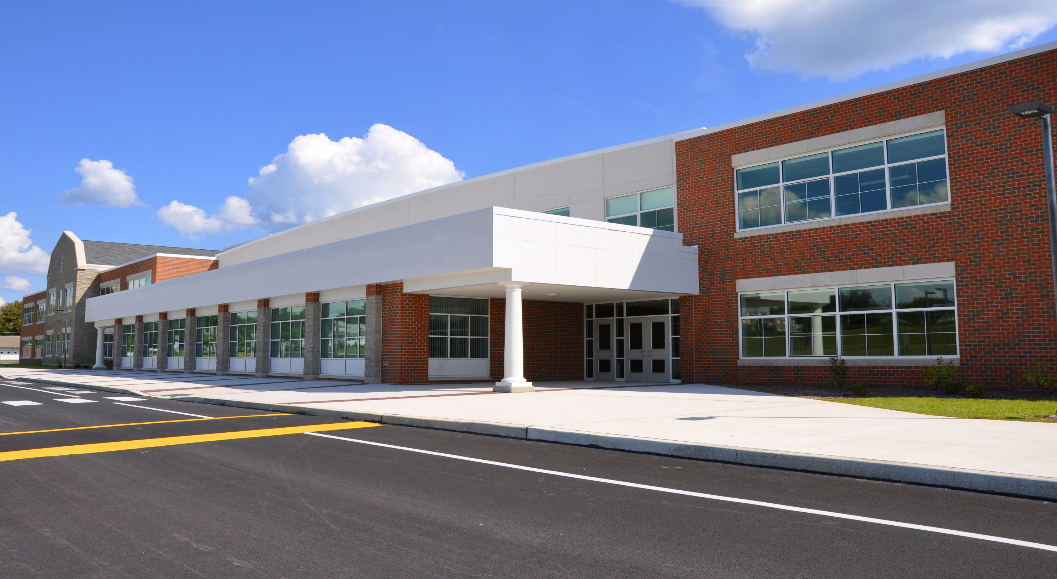
We appreciate the strong support shown for our schools
Your votes have helped schools:
Remodel or build facilities
Improve safety & security
Upgrade technology

Slide 3



Our Community has much to be proud of . . .

Slide 4

Who We Serve
49,253 students
17,630 economically disadvantaged
2,769 students for whom English is a second language
5,423 students with disabilities

Slide 5

What We Accomplish
Above state average graduation rates past five years
73% of graduates enroll in a 2 or 4 year college within 24 months of graduation
2,623 students enrolled in career training programs throughout the region
860 kids in GSRP programming, 2017/18

Slide 6

Schools Are Investing Wisely
Kindergarten Readiness
Third Grade Reading Proficiency
Eighth Grade Math Proficiency
College and Career Readiness
Counseling and Mental Health Programs and Services
School Safety and Security

Slide 7

We’re trying hard to keep up with student needs
By Controlling Costs and Cutting Expenditures

Slide 8
We’re trying hard to keep up with student needs
We’ve saved millions & consolidated:
Consolidation & Shared Services, Shared Positions:
Business, HR, Special Ed, Food Service, Custodial, Highly-Skilled
Specialists for students with special needs, Ottawa Area Information Technology
Consortium, Special Ed Transportation
Outsourcing:
Facilities and Bus Maintenance, Food Services
Notes:
These are Kent’s numbers

Slide 9

School Budgets–Operations
Revenue
Pupil Count (No Control)
Foundation Grant (No Control)
Expenditures
Wages (Control)
Benefits
  Retirement (No Control)
  Health Insurance (No Control)

Slide 10

Foundation Grant

Slide 11

Retirement Cost
School Year | Retirement Rate | OAISD Retirement per Pupil
2008/09 | 16.54% | $854
2009/10 | 16.94% | $881
2010/11 | 20.66% | $1,086
2011/12 | 24.46% | $1,254
2012/13 | 25.92% | $1,338
2013/14 | 29.35% | $1,461
2014/15 | 34.54% | $1,794
2015/16 | 36.31% | $1,904
2016/17 | 36.64% | $1,930

Slide 12
Insurance Cost
School Year | Single | Double | Family | % Increase
2012 | $5,000 | $11,000 | $15,000 | PA 152
2013 | $5,692 | $11,385 | $15,525 | 3.5%
2014 | $5,857 | $12,250 | $15,975 | 2.9%
2015 | $5,992 | $12,531 | $16,342 | 2.3%
2016 | $6,142 | $12,845 | $16,751 | 2.5%
2017 | $6,344 | $13,268 | $17,304 | 3.3%
2018 | $6,561 | $13,720 | $17,892 | 3.4%

Slide 13
Expenditures
 |  | 2010-11 | 2016-17 | $ Change | % Change
Salary/Wage |  | $232,163,937 | $241,318,250 | $9,154,313 | 3.9%
Benefits |  | $117,954,827 | $160,810,683 | $42,855,856 | 36.3%
Purchased Services |  | $24,582,903 | $31,256,080 | $6,673,177 | 27.1%
Supplies |  | $21,763,944 | $19,799,887 | -$1,964,057 | -9.0%
Capitol Outlay |  | $3,481,650 | $4,787,634 | $1,305,984 | 37.5%
 |  | $399,947,261 | $457,972,534 | $58,025,273
Salary/Wage % of Total Budget
Salary/Wage | 55.6% |  | 50.6%
Benefits | 28.2% |  | 33.8%
Comp % of Total | 83.8% |  | 84.4%

Slide 14
Funding Gap
A study of education costs and resources conducted by the School Finance Research Collaborative indicates gap of nearly $1,800 per pupil between state revenues and district expenditures to achieve desired performance results
$1,719
$9,590
$7,871
*Per study commissioned by the School Finance Research Collaborative in 2016.

Slide 15

Schools are under significant financial challenges
Holding cost
increases to just
2.0%
despite declining spending power
Spending down fund balances by
Michigan’s per-pupil spending has fallen by $663 since 2000, while the U.S. average has increased by more than $1,400 per student.
The Herald-Palladium March 4, 2018
$12 million

Slide 16

Studies Find School Funding Inadequate
Schools need $1,719 MORE per pupil.
Michigan Education Finance Study, June 2016
-adjusted to current year
“Schools face financial hardship because of
INADEQUATE state funding, declining enrollment and
more students with special needs.”
Michigan State University Policy Institute, June 2016

Slide 17
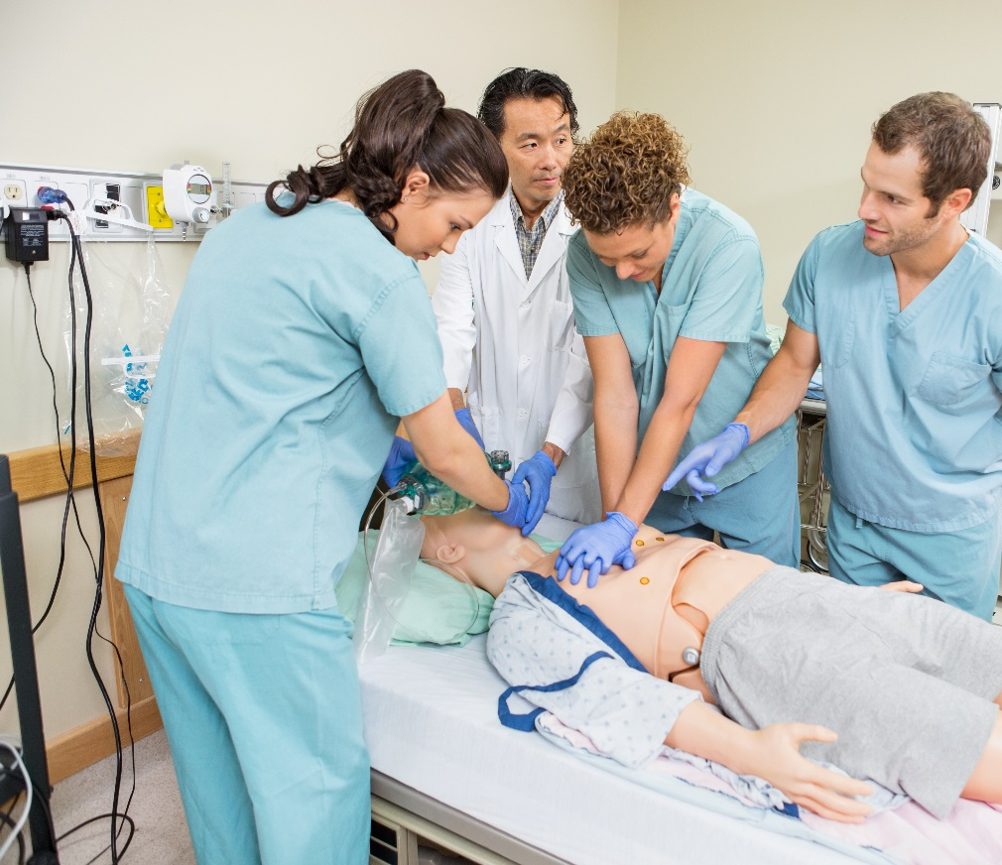



Yet we continue to create new opportunities connecting students to the workplace

Slide 18

Helping students graduate high school
Helping students graduate high school with free and low-cost college credit–saving thousands in tuition even as we struggle to maintain existing academics and staffing.

Slide 19

Current students deserve the same opportunities
as the generations
before them.

Slide 20
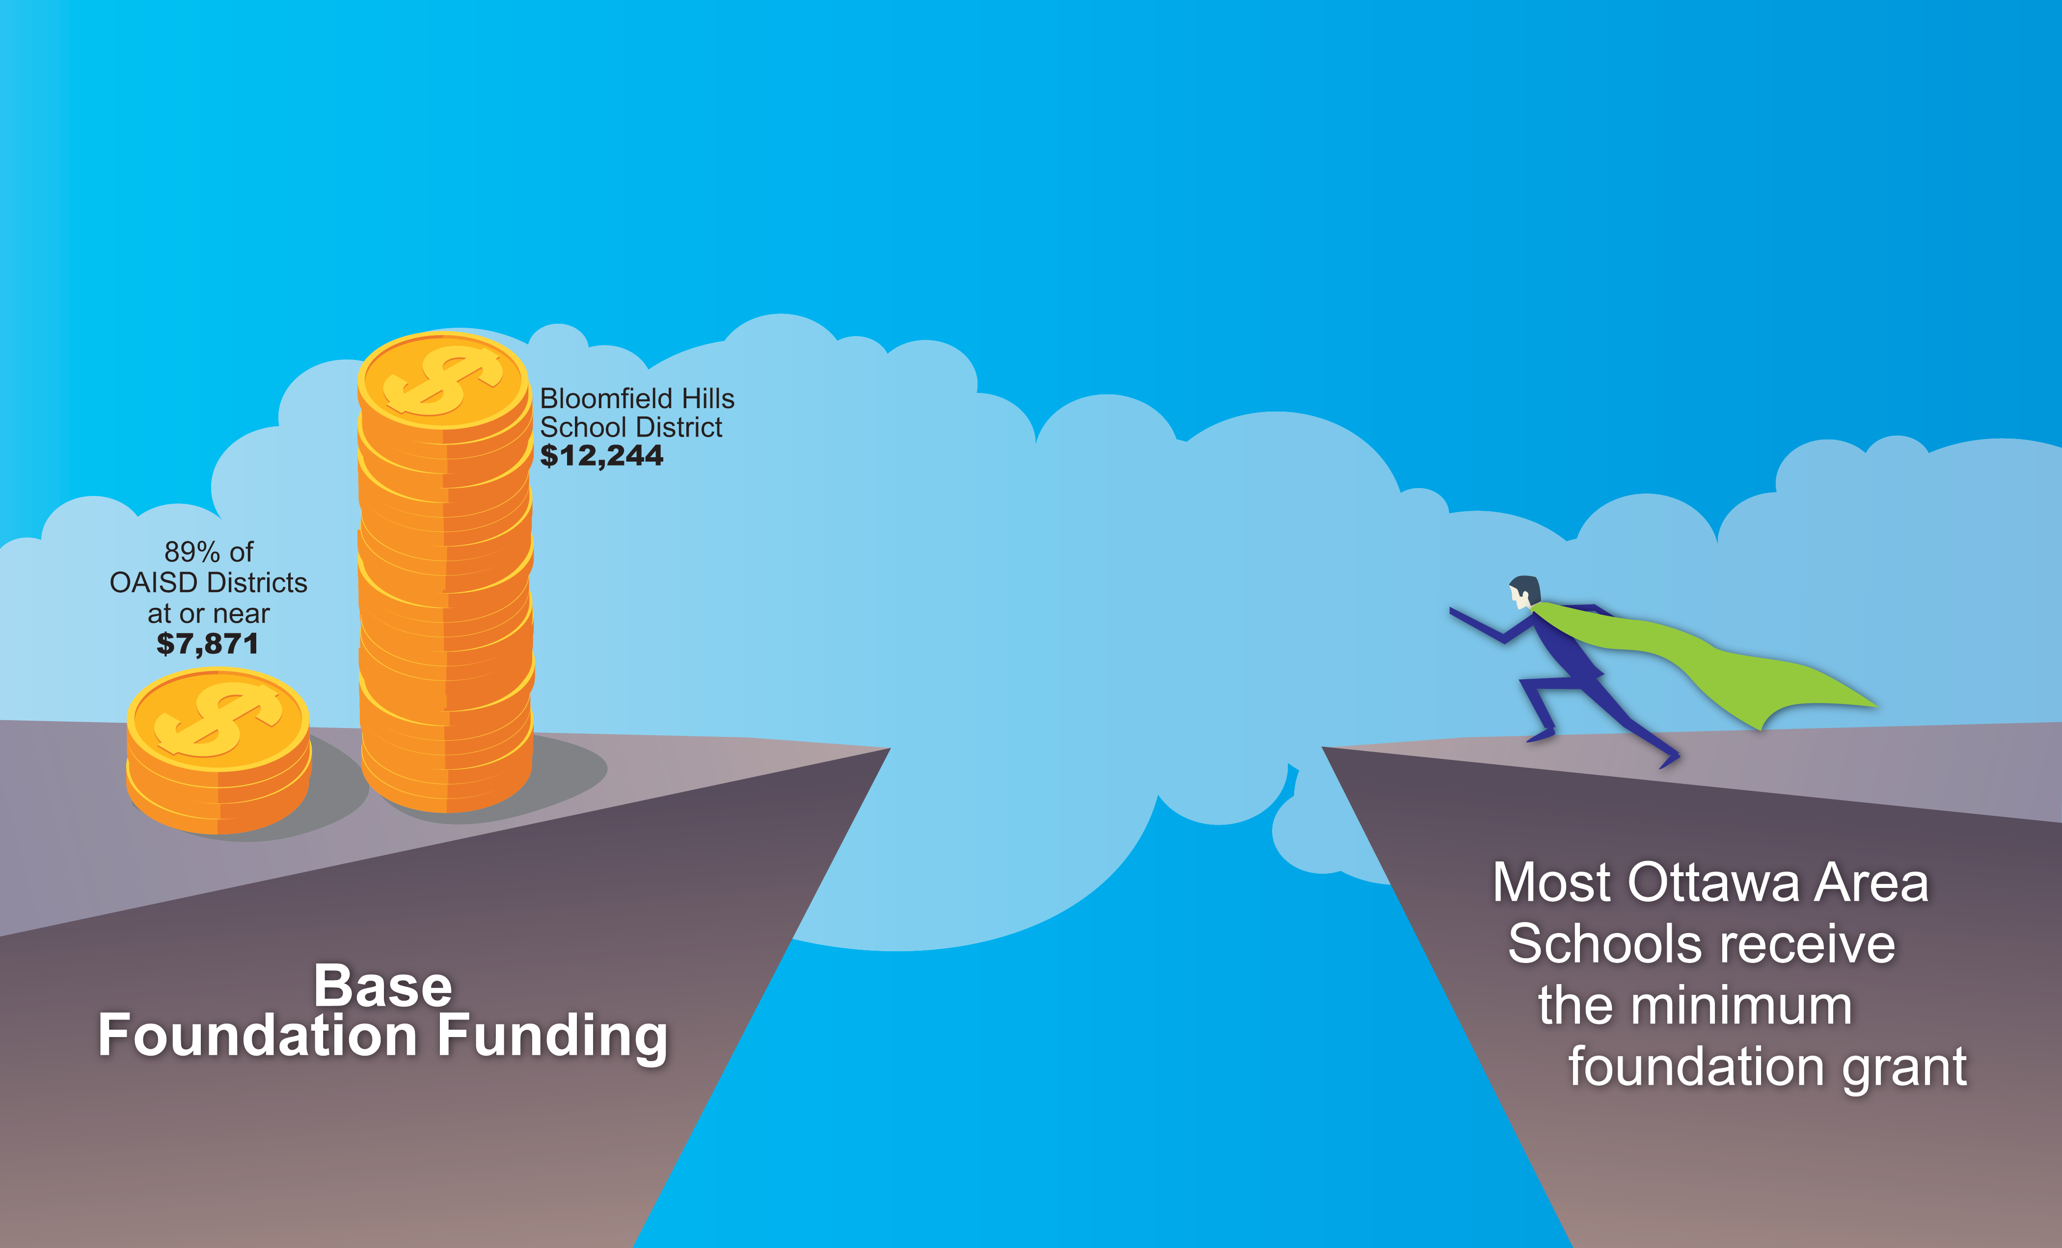
Our reality is a BIG funding gap

Slide 21
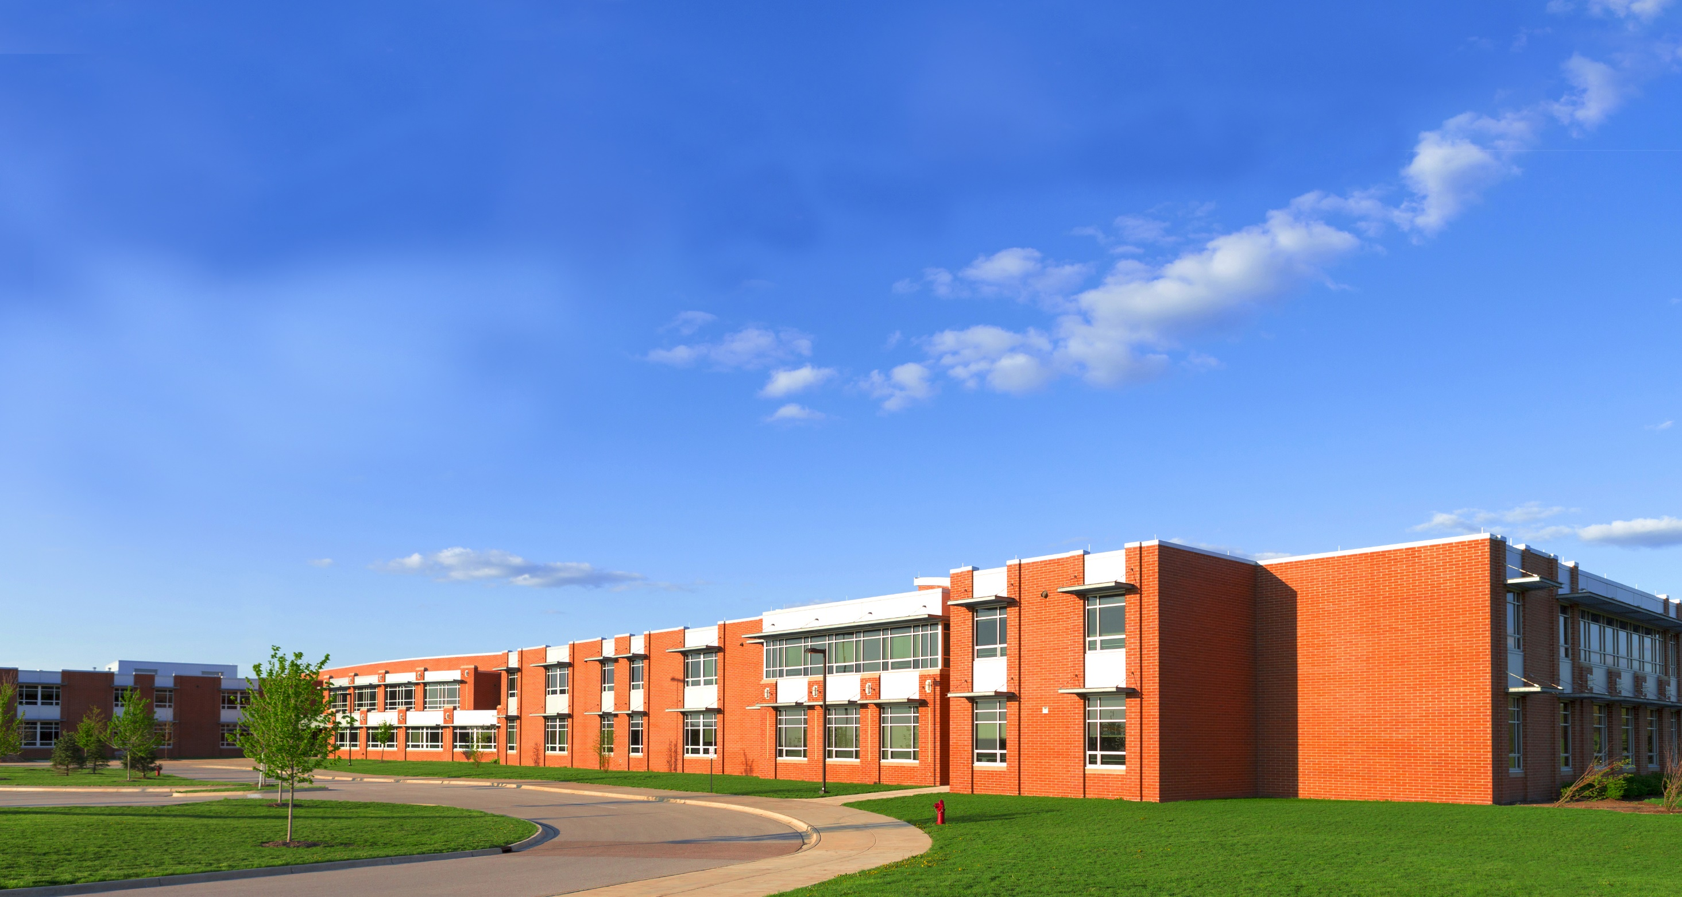
What We Know
High-quality schools are key to attracting families and businesses to West Michigan
Strengthening our schools provides a stronger workforce for businesses in our communities
Communities, business and education have a shared future

Slide 22

Others are choosing to invest
The nation’s TOP 10 education states
spend as much as $18,853 per student
9 of the top 10 in achievement spend more on education than Michigan spends.

Slide 23
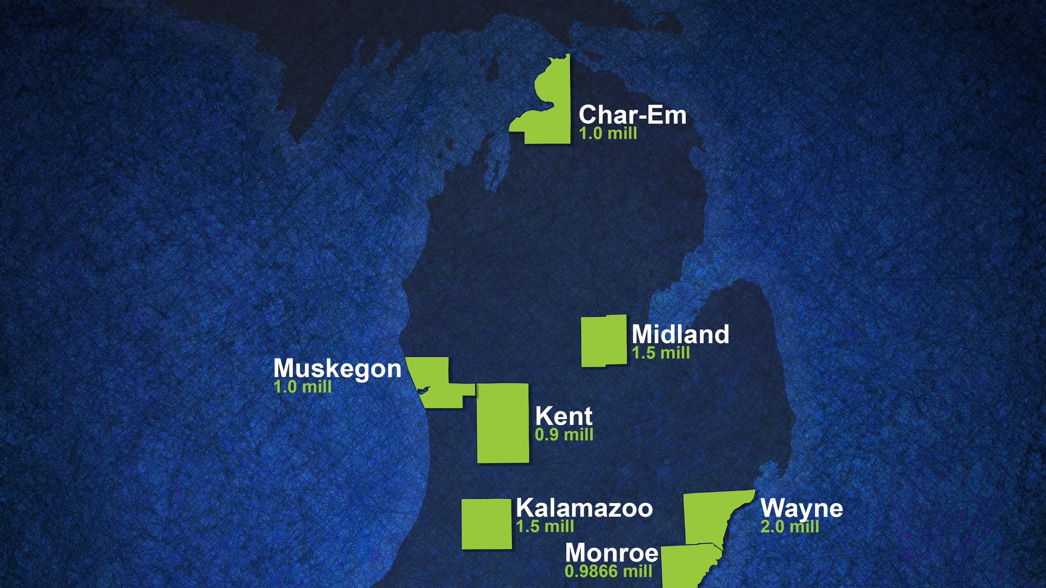
Enhancement
Millages

Slide 24

Our students need more . . .
Preserve and expand high-quality programs and services
Preserve and expand efforts to ensure student safety
Greater connections to college and the world of work making education more relevant

Slide 25

OUR PROPOSAL
One way to increase school operating funds: Enhancement Millage
An Enhancement Millage helps all the districts within the ISD
District school boards asked the ISD board to call for election
If voters approve, the funding is distributed 100% to districts/PSAs on a per-student basis

Slide 26

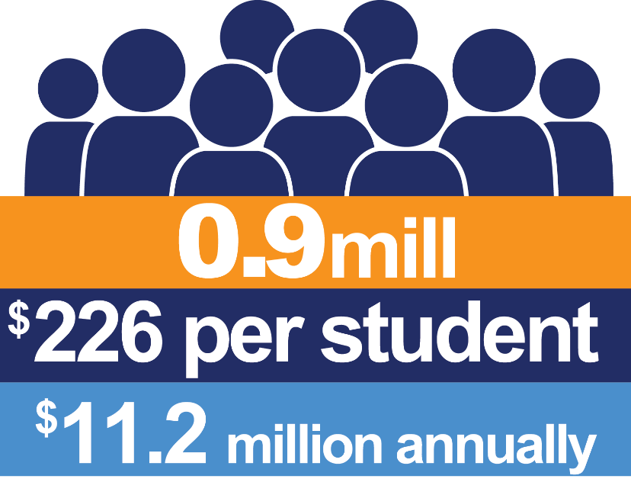
Enhancement Millage
Election Date
Nov. 6, 2018
Voters will be
asked for 0.9 mills
for 10 years

Slide 27
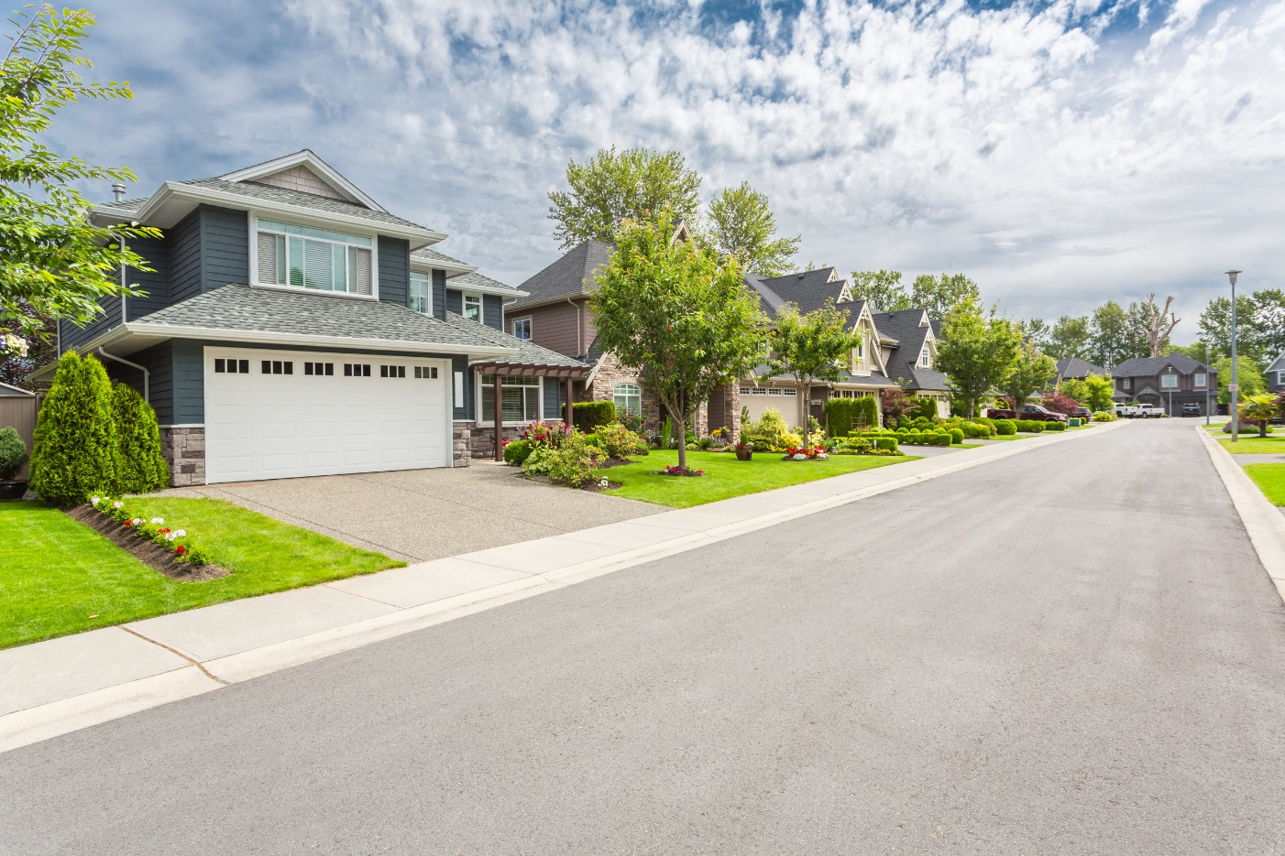
Quality schools make Quality communities
If approved, this would cost the owner of a $100,000 home approximately $3.75 per month, $45 per year.
Home Value SEV Annual Millage Amount
$100,000 $50,000 x 0.9 mills = $45
$200,000 $100,000 x 0.9 mills = $90

Slide 28

What you need to know . . .
By law, funds will be distributed on a per-pupil basis to each local district and public school academy. OAISD receives less than 1% for students attending general fund eligible programs.
Accountability reporting with an independent audit available online

Slide 29




Our Community Survey Results:
90%
84%
82%
82%
Connect Students to World of Work
Maintain
Existing Programs & Services
Increase Mental Health Services
Early College, Giving Students a Head Start

Slide 30
What additional information do you need?
What questions do you have?

Slide 31


